Slide 1
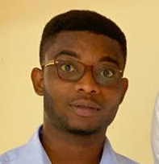
INTRODUCTION TO MICROSOFT POWERBI
Powered by: Code-S
Sir Pasty Asamoah
+233 (0) 546116102
pastyasamoah13@gmail.com
MODULE 1 - 4
Introduction
Data Cleaning
Visualizations
Project

Slide 2
INTRODUCTION TO MICROSOFT POWER BI
Powered by: Code-S
Sir Pasty Asamoah
+233 (0) 546116102
pastyasamoah13@gmail.com
MODULE 1
Part 1 :

Slide 3
INTRODUCTION TO DATABASES
Powered by: Code-S
Sir Pasty Asamoah
+233 (0) 546116102
pastyasamoah13@gmail.com
MODULE 1
Part 1 :

